Slide 1

LIFE EXPECTANCY OF PEOPLE
BY:KARAN KATYAL(IVY PRO SCHOOL)

Slide 2

OBJECTIVE
Perform linear regression analysis to predict life expectancy
Find what factors does not affects average life span of a person
Find what factors does affects average life span of a person

Slide 3
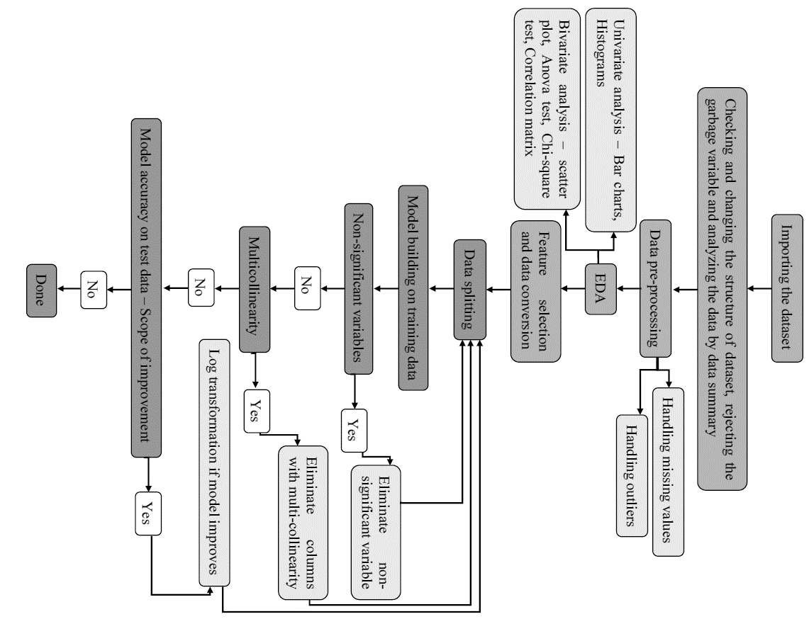

STEPS FOR LINEAR REGRESSION ANALYSIS

Slide 4

DATASET
This dataset consists of 2938 rows and 23 columns.
Dependent variable life expectancy
2 categorical variable and all other are continuous variable

Slide 5
DATA PRE - PROCESSING
MANY VARIABLES HAS MISSING VALUE , WE HAVE FIRSTLY CHECK THE PERECENTAGE OF THE
MISSING VALUES , AND IF THE PERCENTAGE IS LESS THAN 20% WE HAVE TREATED THE
MISSING VALUE THROUGH MEAN , MEDIAN OR MODE OTHERWISE DROP THAT COLUMN.
AFTER FILLING THE MISSING VALUE WE HAVE TO HANDLED THE OUTLIERS , BOTH POSITIVE AND
NEGATIVE OUTLIERS FOUND IN THE DATASET , WE HAVE TO FIX THEM BY USING RANGE.

Slide 6
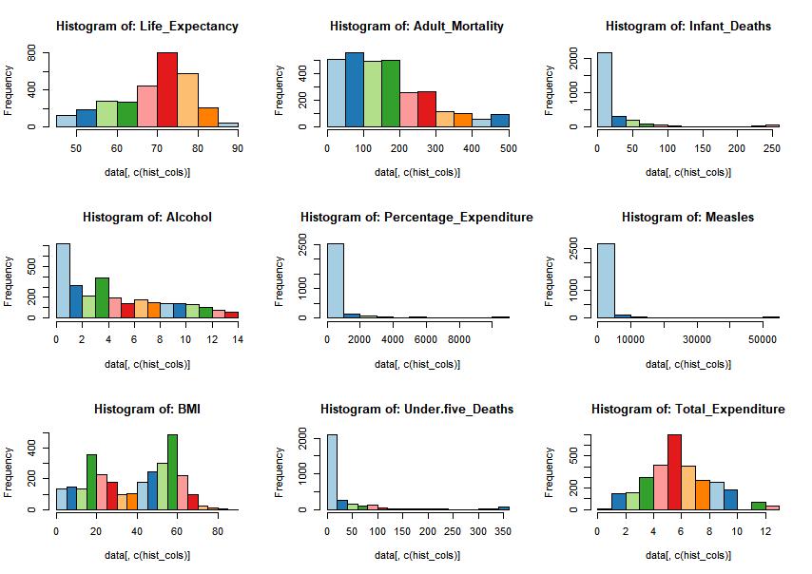
UNIVARIATE ANALYSIS - HISTOGRAM

Slide 7
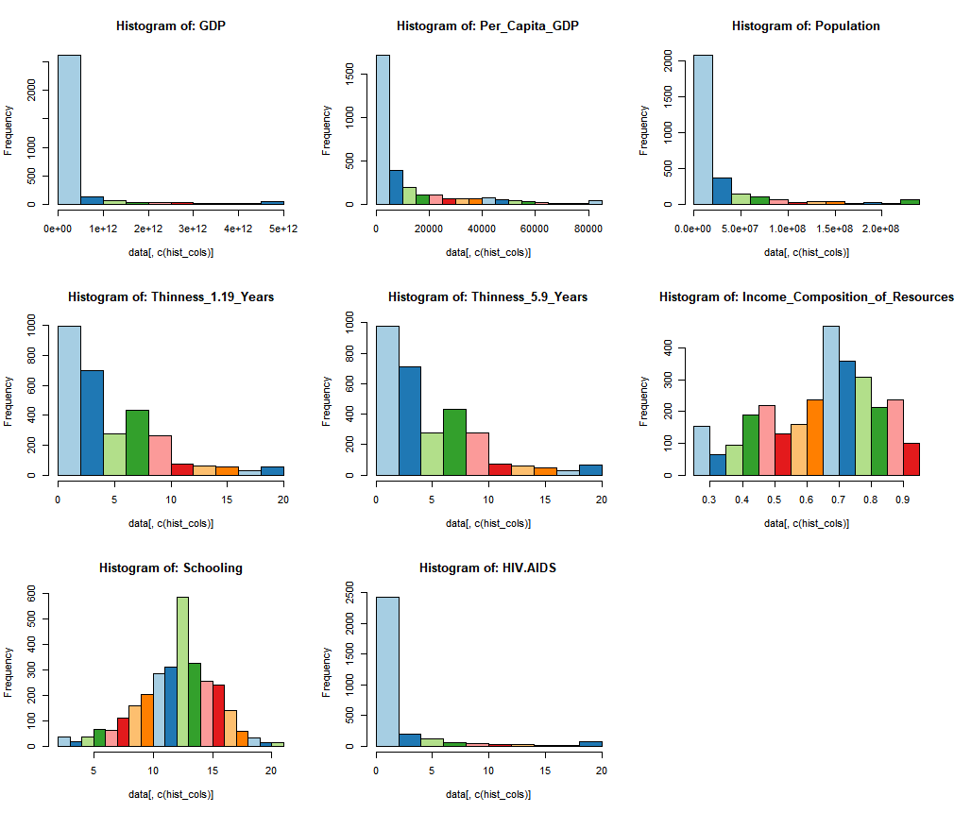
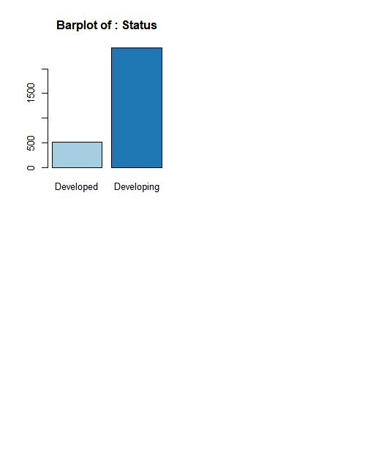
UNIVARIATE ANALYSIS –HISTOGRAM & BARPLOT

Slide 8
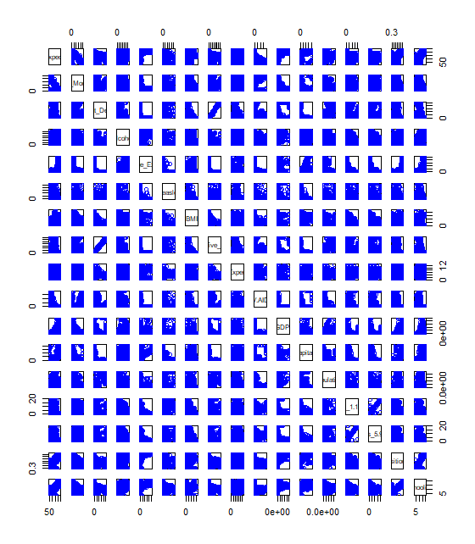
BIVARIATE ANLAYSIS –SCATTER PLOT

Slide 9
CORRELATION MATRIX AND ANNOVA TEST
ACCORDING TO CORRELATION MATRIX MANY VARIABLES SHOWN WEAK CORRELATION ,
THOSE VARIABLES ARE : “Infant_Deaths", "Alcohol", "Percentage_Expenditure", "Measles", "Under.five_Deaths", "Total_Expenditure", "GDP", "Population", "Thinness_1.19_Years" and "Thinness_5.9_Years“
AFTER REMOVING THESE COLUMNS WE HAVE TO DO ANNOVA CHECK , THIS IS DONE FOR CATEGORICAL VARIABLES , AND THE RESULTS SHOWN THAT CATEGORICAL VARIABLES ARE CORRELATED.

Slide 10
MODEL BUILDING :
IN ORDER TO BULID THE MODEL WE FIRST HAVE TO SPLIT THE DATA INTO TRAIN AND TEST , AFTER SPLITTING THE DATA WE BUILD THE LINEAR REGRESSION MODEL WHICH SHOWS THE R SQUARED VALUE OF 0.835 WITHOUT ANY MULTI-COLLINEARITY
BUT AFTER CHECKING WE HAVE INSIGNIFICANT VARIABLE IN THE MODEL AND THAT IS “STATUS” AFTER REMOVING THE VARIABLE WE HAVE TO REBUILT OTHER MODEL WHICH HAVE AN R SQUARED VALUE OF 0.832 WITHOUT ANY MULTI-COLLINEARITY, SO THIS IS OUR FINAL MODEL.

Slide 11

ACCURACY :
MAPE = 4.2637
Median-APE = 3.1836
Mean Accuracy = 95.7362
Median Accuracy = 96.8164

Slide 12
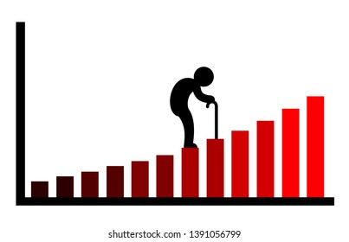
BUSINESS INSIGHTS
Factors like country, year, expenditure etc. does not affect the life expectancy of people
Reaching 15 years of age does not ensure a good life while schooling does
A country's GDP and income composition affect life expectancy more broadly
One can extend their life span by adopting a healthy lifestyle, having proper BMR, proper education, and getting vaccinated on time for each disease

